Slide 1
Florida Department of Education Value-added Model (VAM)
FY2012 Using Student Growth in Teacher and School Based Administrator Evaluations

Slide 2
HOW DID WE GET HERE?
Established by Student Success Act (SB 736) Educator Evaluation System http://www.flsenate.gov/Committees/BillSummaries/2011/html/0736ED
Teacher and School Administrator Evaluations
Professional Practice
Student Learning Growth
FLDOE Student Growth Implementation Committee (SGIC) http://www.fldoe.org/committees/sg.asp
Notes:
Let’s start by reviewing two key elements of the Student Success Act
SGIC included teachers, principals, parents, union representatives, superintendents, school board members, district administrators and postsecondary faculty
Included a school component to the model
The Student Success Act requires the evaluation of instructional personnel and school administrators to consist of two parts: professional practice and student learning growth
Read more at: http://www.flsenate.gov/Committees/BillSummaries/2011/html/0736ED

Slide 3
Established by Student Success Act (SB 736) Teacher Evaluation System
Instructional
Practice (IP)
(4) Highly Effective
(3) Effective
(2) Needs Improvement
(1) Unsatisfactory
2012 Weights
Teacher
IP = 60%/SLG = 40%
Administrator
IP = 50%/SLG = 50%
Final Rating
4-HE
3-Eff
2-NI
1-U
Student Learning Growth (SLG)
(4) Highly Effective
(3) Effective
(2) Needs Improvement
(1) Unsatisfactory
Notes:
SB 736 requires a rating for instructional practice, a rating for student learning growth and final evaluation rating that is a weighted average of the ratings from instructional practice and student learning growth

Slide 4
FY2012 Implementation
Required by law
First time used in evaluations
Based only on FCAT 2.0 Reading/Math
No Algebra 1 EOC student growth scores
No teacher or school administrator will receive a student growth rating less than Effective
Notes:
For the FY2012 teacher and school based administrator evaluations, the District will use student learning growth, as required by law.
The students identified for a school or teacher are those students who were enrolled in either FTE survey 2 or survey 3.
The District has chosen to use 1 year of student growth data, the growth of students from the FY2011 FCAT to the FY2012 FCAT.
The District will not use data from the Algebra 1 EOC due to technical concerns identified by the State.
Student growth will be weighted as 40% of teacher and 50% of school based administrator evaluations.
The District will not assign a teacher or a school based administrator a rating of less than Effective.

Slide 5
IMPORTANT!
It is important to note that measures used in the Florida School Grading system, student proficiency and learning gains, are not a part of the Florida Value-added Model of student learning growth.
Student learning growth is based on the actual scale score on FCAT 2.0 tests. Even if students already score in Achievement Levels 3-5, they still have room to grow.

Slide 6
Growth vs. Proficiency
Growth (Progress)
Growth models measure the amount of academic progress students make between two points in time
Proficiency (Status)
A method for measuring how students perform at one point in time

Slide 7
Growth vs. Proficiency
TEACHER 1
TEACHER 2
Proficiency
Proficiency
Growth

Slide 8
Growth vs. Learning Gains
257
243
251
237
Level 4
Proficiency
Learning Gain

Slide 9
Growth vs. Learning Gains
257
243
251
237
Level 4
Growth
Proficiency
Learning Gain

Slide 10
A More Complete Picture of Student Learning
Growth
> Compare student to own prior performance
> Consider student characteristics
> Progress between points
> Critical to student success
Proficiency
> Compare student to a standard
> Does not consider student characteristics
> Performance at a point in time
> Critical to postsecondary opportunity
&

Slide 11
Overview
Student
Growth
Teacher: Aggregate of Students Taught
School: Aggregate of Students Enrolled
Establishes
Score
Used to Rank School
Used for Evaluation
Establishes
Score
Used to Rank Teacher
Used for Evaluation

Slide 12
VAM & Student Learning Growth
Contribution to a change in a student’s achievement on standardized test
Calculated from a measure of student learning growth over time
http://www.fldoe.org/committees/sg.asp

Slide 13
What is the Student Learning Growth Score?
The difference between
Current test score and
Predicted test score
What is the Predicted Student Score?
Notes:
The difference between a student ‘s current test score and predicted test score is the student learning growth score.
In other words, in order to determine a student’s growth score, it is necessary to know a student’s current and predicted score.
The current score is simply the score a student received.
So what is a student’s predicted score ?

Slide 14
What is the Predicted Student Score?
Student score expected based on prior tests and other characteristics
Notes:
The student’s predicted score is based on a student’s prior test scores, as well as other information about the student.
Just what is this other information.

Slide 15
FLDOE Value-Added Model Variables determining predicted score
OTHER CHARACTERISTICS?
Two or more years of prior achievement scores
Gifted status
Class size
Student Attendance (Days)
Mobility (number of transitions)
Difference from modal age in grade (indicator of retention)
The number of subject-relevant courses in which the student is enrolled
Homogeneity of entering test scores in the class
http://www.fldoe.org/committees/sg.asp
Notes:
The other information was determined by the SGIC. It includes a variety of selected student and class characteristics, including student attendance, mobility, and class size.

Slide 16
FLDOE Value-Added Model Variables determining predicted score
Two or more years of prior achievement scores
Gifted status
Class size
Student Attendance (Days)
Mobility (number of transitions)
Difference from modal age in grade (indicator of retention)
The number of subject-relevant courses in which the student is enrolled
Homogeneity of entering test scores in the class
http://www.fldoe.org/committees/sg.asp
Notes:
The other information was determined by the SGIC. It includes a variety of selected student and class characteristics, including student attendance, mobility, and class size.

Slide 17
FLDOE Value-Added Model Variables determining predicted score
Students with Disabilities (SWD) status
Language impaired
Hearing impaired
Visually impaired
Emotional/behavioral
Specific learning disability
Dual sensory impaired
Autism spectrum disorder
Traumatic brain injury
Other health impaired
Intellectual disability
English Language Learner (ELL) status
LY
http://www.fldoe.org/committees/sg.asp
Notes:
The student characteristics also include SWD status and ELL status.

Slide 18
FLDOE Value-Added Model Student Success Act specifically excludes these student characteristics
Gender
Race
Ethnicity
Socioeconomic status
Notes:
You may be wondering why this list of variables does not includes student gender, race, ethnicity, or socioeconomic status. This is because the Student Success Act specifically excludes these student characteristics from consideration.
18

Slide 19
What is the Student Learning Growth Score?
Let’s take a look at
the predicted score
Notes:
So know that we know a student’s current score and predicted score, we can calculate a student’s learning growth score
It is simply the difference between the predicted and current score.
Let’s work through some examples of how this works.

Slide 20
What is the Predicted Student Score?
…100 200 300 400 500 600 700 800 900 1000…
(FY12 FCAT)
CURRENT TEST
Y axis is Current Year FCAT Score
X axis is Prior Year FCAT Score
…100 200 300 400 500 600 700 800 900 1000…
PRIOR TEST
(FY11 FCAT)
Notes:
Let’s say we want to look at students whose prior test scores were from the FY10 FCAT and their current test scores were from the FY11 FCAT .
We will use these two years throughout the presentation; however, the reference to current and prior test indicates that this will work for any set of consecutive year scores.

Slide 21
What is the Predicted Student Score?
…100 200 300 400 500 600 700 800 900 1000…
(FY12 FCAT)
900
800
CURRENT TEST
Answer:
Average of
current scores
of similar students
700
600
500
400
300
…100 200 300 400 500 600 700 800 900 1000…
PRIOR TEST
(FY11 FCAT)
Notes:
So, once you know the FY11 FCAT predicted score, you can know the students who were above their predictions or below their predictions.

Slide 22
Student Learning Growth is the Amount Above or Below Predicted Score
…100 200 300 400 500 600 700 800 900 1000…
(FY12 FCAT)
900
800
CURRENT TEST
700
PREDICTED SCORE
600
600
500
400
300
…100 200 300 400 500 600 700 800 900 1000…
PRIOR TEST
(FY11 FCAT)
Notes:
So, once you know the FY11 FCAT predicted score, you can know the students who were above their predictions or below their predictions.

Slide 23
Student Learning Growth is the Amount Above or Below Predicted Score
…100 200 300 400 500 600 700 800 900 1000…
(FY12 FCAT)
900
ACTUAL SCORE
800
CURRENT TEST
Positive Student
Growth Score
700
PREDICTED SCORE
600
600
Negative Student
Growth Score
500
ACTUAL SCORE
400
300
…100 200 300 400 500 600 700 800 900 1000…
PRIOR TEST
(FY11 FCAT)
Notes:
So, once you know the FY11 FCAT predicted score, you can know the students who were above their predictions or below their predictions.

Slide 24
Growth vs. Proficiency
TEACHER 1
TEACHER 2
Did Student B meet or exceed the predicted score?
Did Student J meet or exceed the predicted score?

Slide 25
Student Growth
The difference between the current and predicted scores represents the value added by the teacher and the school
Residual:
The amount of growth by a student
Residual

Slide 26
Determining the Student Learning Growth by School
…100 200 300 400 500 600 700 800 900 1000…
(FY12 FCAT)
Example:
All Grade 5 Reading Students in Florida
CURRENT TEST
The diagonal line is the predicted growth observed among similar students
.
…100 200 300 400 500 600 700 800 900 1000…
PRIOR TEST
(FY11 FCAT)
DRE
Notes:
Here is another scatter plot with a different group of students and with different FY11 and FY10 FCAT scores.
The diagonal line is the FY11 FCAT predicted growth for this set of students, along with their FY11 and FY10 FCAT scores. The predicted growth is determined mathematically.
It answers the question: what is average growth for this set of students?

Slide 27
Determining the Student Learning Growth by School
…100 200 300 400 500 600 700 800 900 1000…
(FY12 FCAT)
The difference between the predicted and actual scores is the growth.
The average of the growth of students within a school produces the school score for a subject/grade.
CURRENT TEST
…100 200 300 400 500 600 700 800 900 1000…
PRIOR TEST
(FY11 FCAT)
Notes:
For example, here are the students that were assigned to the three teachers teaching the same subject at the same grade.

Slide 28
Student Growth Scores
Teacher VAM
School Component
Notes:
The SGIC determined that in order to determine a teacher’s value added score ,it is necessary to determine both the effect the teacher has on his/her students and the effect the school has on the students.
The formula used to calculate the teacher effect and school component is displayed.

Slide 29
Student Growth Scores Teacher/School
State calculates scores for each grade and subject separately
Therefore, a teacher/school may have more than one score

Slide 30
Student Growth Scores Teacher/School
Teacher of both 9th and 10th grade students
Grade | Subject | Student Count | Teacher VAM
9 | Reading | 18 | 6.04
10 | Reading | 16 | -0.08
Two Different Scores

Slide 31
Comparing Scores
Comparing scores across subjects/grades
FCAT 2.0 scale has inconsistencies

Slide 32
Common Score
State creates scores on common scale
Example: Jane Doe teaches intensive reading
Grade | Subject | Student Count | Teacher VAM | Common Score
9 | Reading | 18 | 6.04 | 1.07
10 | Reading | 16 | -0.08 | -0.01

Slide 33
Common Score
State creates scores on common scale
Example: Jane Doe teaches intensive reading
Grade | Subject | Student Count | Teacher VAM | Common Score
9 | Reading | 18 | 6.04 | 1.07
10 | Reading | 16 | -0.08 | -0.01
 | COMMON SCORE |  |  | .052

Slide 34
Ranking Scores
87% - 100% HIGHLY EFFECTIVE
Jane Doe
15% - <87 %
EFFECTIVE
2% - <15% DEVELOPING
<2% UNSATISFACTORY
Schools in State
Teachers in State
Notes:
The calculation of student learning growth for student D is the same.

Slide 35
Jane Doe: Teacher Example
Jane Doe’s common score is 0.052
This score is ranked among all teachers in the state with a Reading score
This gives Jane a percent rank of 68.48 when compared to all other teachers in the State
This percent rank translates to “Effective”

Slide 36
Percent Ranks and Ratings
State generates a percent rank for each teacher, school, district
Reading score is ranked among all Reading scores in the state (Grades 4-10)
Math score is ranked among all Math scores in the state (Grades 4-8, No Algebra)
Reading + Math score is ranked among Reading + Math scores in the state
Percent ranks are placed on the District Student Growth Rating Scale

Slide 37
District Evaluation System Implementation Plan
Teachers
FCAT Teachers use teacher VAM score for students of grade/subjects taught
Non-FCAT Teachers use combined reading/math school score
Teacher assigned to 2 schools, use weighted average of 2 schools combined reading/math scores
Teacher assigned to more than 2 schools, use District reading/math score combined
Administrators
Principals & Assistant Principals use combined reading/math school score

Slide 38
Established by Student Success Act (SB 736) Teacher Evaluation System
Instructional
Practice (IP)
(4) Highly Effective
(3) Effective
(2) Needs Improvement
(1) Unsatisfactory
2012 Weights
Teacher
IP = 60%/SLG = 40%
Administrator
IP = 50%/SLG = 50%
Final Rating
4-HE
3-Eff
2-NI
1-U
Student Learning Growth (SLG)
(4) Highly Effective
(3) Effective
(2) Needs Improvement
(1) Unsatisfactory
Notes:
SB 736 requires a rating for instructional practice, a rating for student learning growth and final evaluation rating that is a weighted average of the ratings from instructional practice and student learning growth

Slide 39
Final Teacher Evaluation Rating
 | Student Learning Growth (40%)
 |  | 1 | 2 | 3 | 4
Instructional Practice (60%) | 1 | 1 | 1.4 | 1.8 | 2.2
 | 2 | 1.6 | 2 | 2.4 | 2.8
 | 3 | 2.2 | 2.6 | 3 | 3.4
 | 4 | 2.8 | 3.2 | 3.6 | 4
Hold Harmless
Hold Harmless
WEIGHTED-AVERAGE
HE | Eff | NI | U
3.2 - 4.0 | 2.1 - 3.1 | 1.2 - 2.0 | 1.0 - 1.1

Slide 40
Final Administrator Evaluation Rating
 |  | Student Learning Growth (50%)
Professional Practice (50%) |  | 1 | 2 | 3 | 4
 | 1 | 1 | 1.5 | 2 | 2.5
 | 2 | 1.5 | 2 | 2.5 | 3
 | 3 | 2 | 2.5 | 3 | 3.5
 | 4 | 2.5 | 3 | 3.5 | 4
WEIGHTED-AVERAGE
HE | Eff | NI | U
3.2 - 4.0 | 2.1 - 3.1 | 1.2 - 2.0 | 1.0 - 1.1

Slide 41
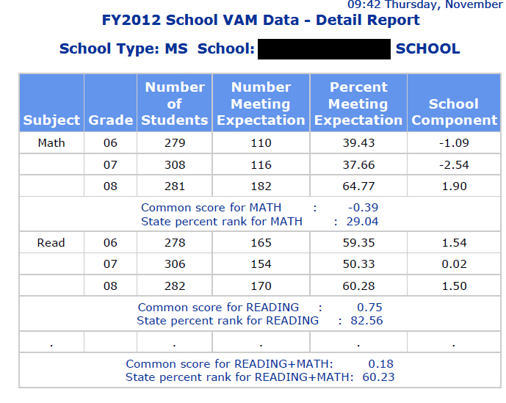
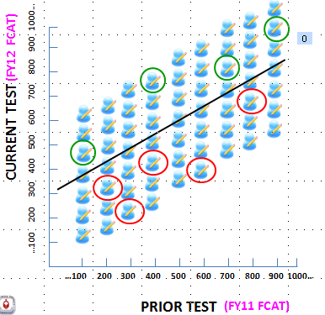
Sample School Report
Effective

Slide 42
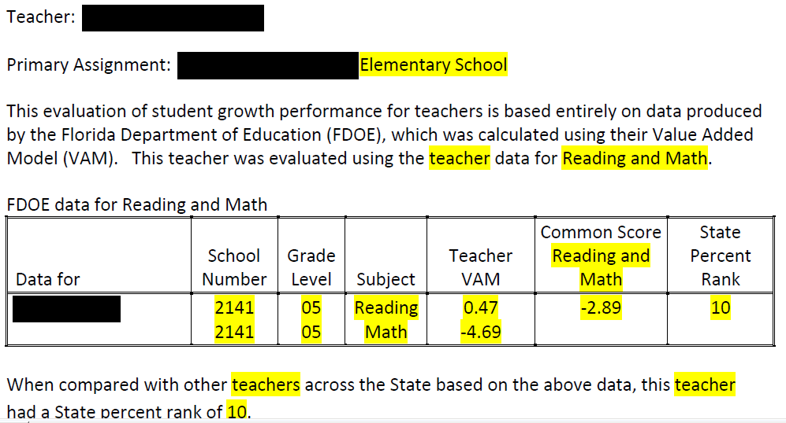
Sample teacher report

Slide 43
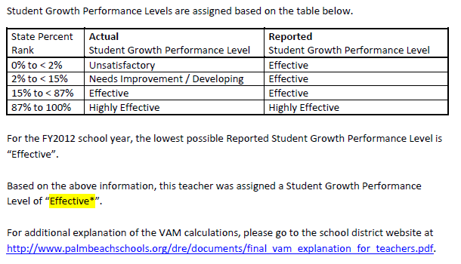
Sample Teacher Report

Slide 44
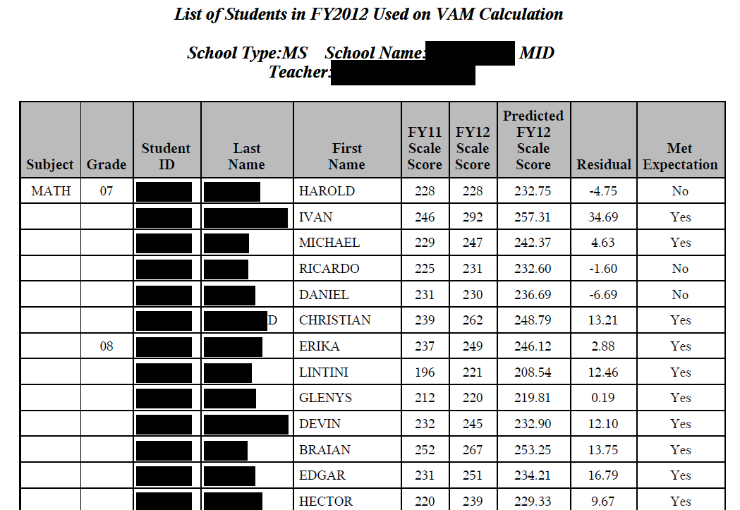
Sample Student Report

Slide 45
Resources
Research & Evaluation Website (PPT)
FLDOE Resources on Student Growth
State Educator Evaluation System (Video)
Value-Added Model White Paper (Word, 841KB)
Value-Added Model Technical Report (Word, 601KB)
Presentation on the Value-Added Model (PDF, 103KB)
FDOE - VAM Course Codes used in Value-Added Model
Oak Tree Analogy of Value-added

Slide 46
CONTACT
Student Growth (VAM)
Mark Howard, Director
Research, Evaluation and Assessment
Mark.howard.1@palmbeachschools.org
561-434-8781
Educator Evaluations
Kathy Orloff, Director
Professional Development
Kathy.orloff@palmbeachschools.org
561-776-3696
Educator Evaluations
Dianne Wyatt, Manager
Human Resources/Professional Development
diane.wyatt@palmbeachschools.org
561-366-6112

