Slide 1
FY17 Evaluation Overview: Student Performance Rating
Notes:
Thank you for taking the time to view this explanation of the 2017 Teacher Evaluation System. This presentation will review the general components of the Evaluation System. If you have specific questions, please feel free to use the link on your teacher letter in PeopleSoft to submit an inquiry.

Slide 2
FY17 Final Teacher Evaluation Rating Components and Weights
(IP) Instructional Practice Rating - 57%
(SP) Student Performance Rating - 33%
(PG) Professional Growth Rating - 10%
FINAL EVALUATION RATING - 100%
Notes:
The Teacher Evaluation is divided into three components:
The Instructional Practice Rating which includes the teacher observations and represents 57% of the total evaluation score.
The Student Performance Rating which includes VAM and the local Cohort Models of Student outcomes and represents 33% of the total evaluation score.
The Professional Growth Rating which includes teacher improvement on their Professional Growth Plan and represents 10% of the total evaluation score.

Slide 3
(IP) Instructional Practice – 57%
Based on the Palm Beach Model of Instruction
Domain 1: Design Questions 2, 3 or 4
Category 1A: 15 data marks
Category 1B & 2: 10 data marks
(SPR) Student Performance Rating – 33%
Survey 2/3 student match except semester long acceleration courses
Students must have both pre and post-test
At least 10 students
The State VAM is based on both FY16 and FY17 Students.
(PG) Professional Growth – 10%
Deliberate Practice - Professional Growth Plan
Notes:
The Instruction Practice Score is based on the Palm Beach Model of Instruction and focuses on Marzano Domain 1; design questions 2, 3, & 4. Teachers in Category 1A is based on 15 and Category 1B and 2 are based on 10 data marks throughout the year.
The Student Performance Rating is based on students assigned to a teacher both survey 2 and 3, with the exception of the AP,IB, & AICE semester long courses, and who have both the pre and post test scores for at least 10 students. This year the state computed VAM scores are based on students assigned to teachers in both the 2016 and 2017 school years. The two-year VAM is used to increase the number of students contributing to a teacher’s VAM score to make for a more accurate measure of Teacher impact on students.
The Professional Growth Score is based on a teacher’s growth in Deliberate Practice. Teachers are rated on their selected element as:
Unsatisfactory if the element is not rated
Needs Improvement/ Developing if there is no growth on the element
Effective if the teacher improves one level
Highly Effective if the teacher grows two levels or is rated as Innovating

Slide 4
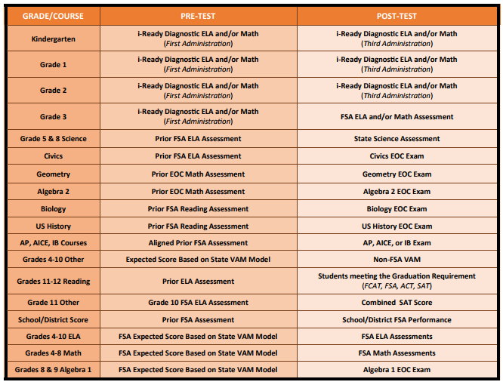
FY17 Student Performance Rating Models
Notes:
There are several different assessments used in the Student Performance Rating in order to capture teacher impact on students as completely as possible. As in prior years, Grade 4-10 ELA, 3-8 Math, and 8-9 Algebra teachers have a VAM score computed by the Florida Department of Education. As mentioned earlier the ELA and Math VAM scores are based on both 2016 and 2017. For most of the remaining teachers the assessments used in 2016 were also used in 2017. However, Kindergarten and Grades 1 and 2 used the iReady assessment for the first time this year.
For iReady the local cohort model was used to determine the Student Performance Rating. For Kindergarten through Grade 2, teachers were grouped into cohorts based on their students average performance on the fall iReady Diagnostic. Within these cohorts, teachers were ranked based on their students’ average scale score growth between the fall and spring iReady Diagnostics.
For Grade 3, the fall iReady Diagnostic was used to group the teachers into cohorts and then within the cohorts the teachers were ranked based on the average scale score of their students on the Grade 3 FSA.
For those teachers who do not have a test available receive either the non FSA VAM which is based on the percent of students who met their expected score.
Teachers with fewer than 10 students in any of the models will receive the school VAM rating, teachers in district departments receive the district VAM rating.

Slide 5
Value Added Model
Notes:
We will now explain the state Value Added Model (VAM).

Slide 6
FDOE Value-added Model (VAM)
Contribution to a change in a student’s achievement on standardized test
Calculated from a statistical measure of student learning growth
Uses two years worth of student scores to more accurately determine teacher impact
http://www.fldoe.org/committees/sg.asp
Notes:
The state VAM model is intended to determine the teachers’ impact on the change in student achievement.
The model is based on a statistical measure of students learning growth compared to the average growth of similar students.
For this year the model includes 2 years of student test scores, when available, in order to more accurately measure teacher impact.
While based on a complex statistical model, the VAM score can be explained simply…

Slide 7
What is the VAM Score?
The difference between
Current score and
Expected score
What is the Expected Score?
Notes:
…as the difference between a student ‘s current test score and expected test score.
What is the student’s Expected Score?
The Expected Score is based on a student’s prior test scores, as well as other information about the student.
What other information is used to determine the Expected Score?

Slide 8
FLDOE Value-Added Model Variables determining expected score
One to Two years of prior scores
Gifted status
Class size
Student Attendance (Days)
Mobility (number of transitions)
Difference from modal age in grade (indicator of retention)
Number of subject-relevant courses enrolled
Homogeneity of entering test scores in the class
Students with Disabilities (SWD) status
English Language Learner (LY) status
http://www.fldoe.org/committees/sg.asp
Notes:
In addition to up to two years of prior test scores, the Expected Score is based on:
a student’s Gifted Status
the number of students in a student’s subject- relevant courses
a student’s daily attendance record
a student’s mobility (number of school transitions)
a student’s age difference from what is normal for the grade
the count of subject- relevant courses on the student’s schedule
the similarity student’s prior achievement to those in their subject- relevant courses
a student’s disability status
a student’s English Learner status if LY
These factors are examined statewide to determine the Expected score for each student based on the average performance of students who are similar on these factors.

Slide 9
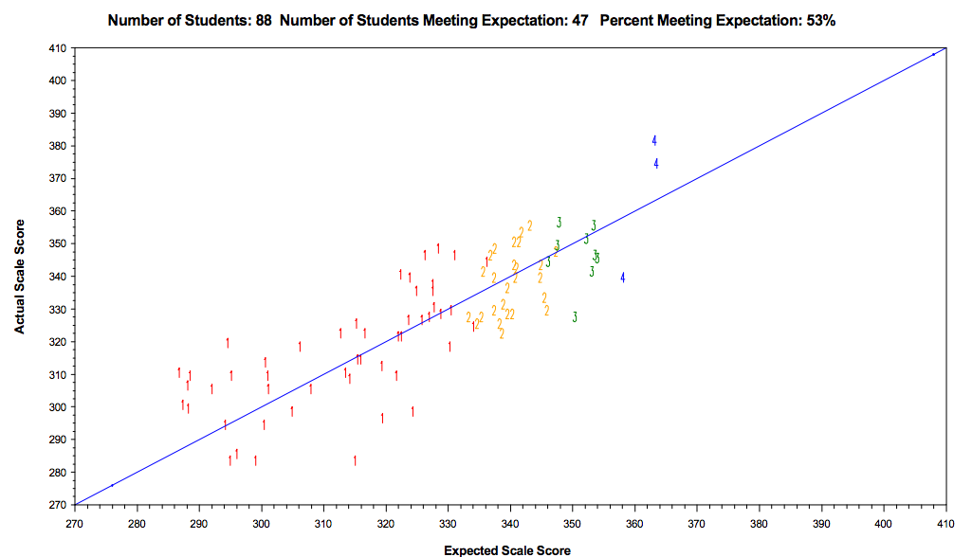
WHAT IS THE “EXPECTED” SCORE”
ACTUAL SCORE
EXPECTED SCORE
Notes:
We are often asked to provide a student’s expected score at the beginning of the school year. However, this is not possible because it is not a predicted score. Since the expected score is based on the average performance of similar students statewide it is not set until after the test is given.
A teacher’s students will all perform differently relative to their expected score. Some students’ actual score will fail to meet the expectation, and others will meet or exceed the expectation. This will provide a percentage of students whose actual score met their expected score, however, this percentage does not represent the VAM score.

Slide 10
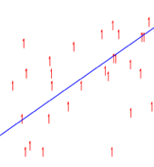
The difference between the expected and actual scores is the growth.
The average of the growth of students assigned produces the score for a teacher.
WHAT IS THE “SCORE”
Notes:
The VAM score is not based on the percent of students who meet the expected score but the extent to which each student met or failed to meet their expected score. The difference between each student’s actual and expected score represents the student’s learning growth score.
The average of these differences represents a teacher’s score.

Slide 11
What are Confidence Intervals
Express the level of confidence that if repeated, score would repeat within same range
Factors may affect the confidence interval
size of sample (number of students)
population variability (range of scores)
A larger sample normally leads to a better estimate
WHAT ARE CONFIDENCE INTERVALS?
Notes:
A teacher’s VAM score is not the sole determinant of a teacher’s Student Performance Rating. To determine the teacher’s Student Performance Rating FDOE also uses the confidence interval around the VAM score to rate the teacher as Highly Effective through Unsatisfactory.
A confidence interval is a statistical measure of certainty that if the measure were repeated the score would fall within a set range of the actual score. The confidence interval is dependent on the number students and the variability of test scores. A larger sample with similar scores leads to a smaller confidence interval.

Slide 12
State VAM model uses confidence intervals to determine Student Performance Ratings.
Notes:
To determine a teacher’s rating, the FDOE uses the VAM score and the 68 and 95% confidence intervals. In this depiction
the black line represents the Standard Aggregate Score of 0 which is the state average teacher impact.
the purple diamond represents the teacher’s VAM score
the red bar represents the 68% confidence interval, or 68% certainty
the orange bar represents the 95% confidence interval or 95% certainty
For a teacher to be rated Highly Effective: the VAM score and both 68% and 95% Confidence Intervals are above 0.
For a teacher to be rated Effective: the VAM score can be above or below 0 with some portion of the 68% confidence interval above 0 and some portion of the 95% confidence interval below 0.
For a teacher to be rated Needs Improvement: the VAM Score is less than 0, the entire 68% Confidence Interval is below 0, but some portion of the 95% Confidence Interval lies above 0.
For a teacher to be rated Unsatisfactory: the VAM score and both 68% and 95% Confidence Intervals are below 0.

Slide 13
Local Cohort Models
Notes:
The state VAM models apply to approximately one third of District teachers. For the remainder of the Student Performance Rating the district uses locally developed cohort models.

Slide 14
AVERAGE LEVEL OF STUDENTS
 | STU | Teacher 1 | Teacher 2 | Teacher 3 | Teacher 4
Achievement Levels | 1 | 1 | 2 | 3 | 5
 | 2 | 2 | 2 | 3 | 5
 | 3 | 2 | 2 | 3 | 5
 | 4 | 1 | 1 | 2 | 3
 | 5 | 1 | 2 | 3 | 5
 | 6 | 2 | 2 | 3 | 3
 | 7 | 1 | 2 | 3 | 5
 | 8 | 2 | 2 | 3 | 5
 | 9 | 2 | 2 | 4 | 3
 | 10 | 2 | 2 | 3 | 5
 | 11 | 1 | 3 | 5 | 4
 | 12 | 1 | 3 | 5 | 4
 | 13 | 1 | 2 | 3 | 4
 | 14 | 1 | 3 | 5 | 5
 | 15 | 2 | 2 | 3 | 5
 | 16 | 2 | 1 | 2 | 4
 | 17 | 1 | 1 | 2 | 3
 | 18 | 2 | 2 | 3 | 5
 | 19 | 2 | 2 | 3 | 5
 | 20 | 1 | 2 | 3 | 5
 | Avg. | 1.50 | 2.00 | 3.24 | 4.53
Notes:
Teachers are assigned students of differing levels of achievement. As such it would be unfair to compare teachers with high achieving students to those of low achieving students. The local models groups teachers into cohorts based on the average prior achievement, based on the identified pre-test, of the students they were assigned both Survey 2 and 3.
In the example here these four teachers would be assigned to different cohorts.

Slide 15
General Cohort Model
 | Teacher Cohorts* based on Average Pre-Test Performance
 | Low | Low- Moderate | High- Moderate | High
Teacher Rank based on Average Current Performance** | 82%+ | 82%+ | 82%+ | 82%+
 |  |  | 19-82% | 19-82%
 |  | 19-82%
 | 19-82%
 | 9.5-19% |  |  | 0-9.5%
 |  | 0-9.5%
 | 0-9.5%
9.5-19%
9.5-19%
9.5-19%
0-9.5%
*Acceleration Model only uses 3 cohorts and ranks based on the difference between teacher district passing rate.
** K-2 iReady Model ranks based on student growth.
Notes:
Each of the local models includes 4 cohorts with the exception of the AP, IB, and AICE model which uses 3 cohorts due to the limited range of prior student achievement for students enrolling in these courses.
Once the teacher’s are assigned to cohorts, they are then ranked within the cohort based on their students’ average achievement on the post test.
While the general rules are similar, the Kindergarten to Grade 2 iReady and AP, IB, and AICE models have slight differences:
The iReady model is ranked based on the average student growth between the fall and spring diagnostics.
The AP, IB, and AICE model is ranked based on the difference between the teacher and district pass rate for each test. In addition, teachers with 100% pass rates are rated Highly Effective regardless of ranking.
A teacher’s rank is used to rate their impact relative to other teachers with similar students based on the average prior achievement of their students. The proportion of teachers assigned each rank is based on the proportion of teachers with each rating, Highly effective through Unsatisfactory, based on the FDOE VAM model. Of each cohort approximately
the top 18% are highly effective
63% are effective
9.5% are Needs Improvement
the bottom 9.5% are Unsatisfactory

Slide 16
Teachers with Multiple Models Combined Ratings
Student Performance Score Rating - Combination Models
 | Rating 1 | Rating 2 | Rating 3 | Average | Final Rating
Teacher 1 | Effective (3) | Effective (3) | Unsatisfactory (1) | 7/3 = 2.3 | Needs Improvement
Teacher 3 | Highly Effective (4) | Effective (3) |  | 7/2 = 3.5 | Highly Effective
Student Performance Score Combination Ratings | Average
Highly Effective (4) | 3.5 – 4.0
Effective (3) | 2.5 - 3.4
Needs Improvement/Dev (2) | 1.5 - 2.4
Unsatisfactory (1) | 1.0 -1.4
Notes:
For teachers with multiple models, the numeric ratings within each model are averaged to determine the final Student Performance Rating for the teacher. The numeric value of each rating are:
4 for Highly Effective
3 for Effective
2 for Needs Improvement
1 for Unsatisfactory
For example, a grade 5 classroom teacher has a rating based on the ELA and Math VAM score. In addition, this teacher would have a rating based on the science local cohort model. If this teacher were rated Highly Effective, 4, on one model and Needs Improvement, 2, on the other model the final Student Performance Rating would average out to a 3 or Effective.

Slide 17
FY 17 Evaluation Rating Possibilities
HE | E | NI | U
3.2-4.0 | 2.1-3.1 | 1.2-2.0 | 1.0-1.1
Inst. Practice (57%) | Student Performance (33%) | Deliberate Practice (10%) | Overall Score
4 | 4 | 4 | 4.0
4 | 4 | 3 | 3.9
4 | 4 | 2 | 3.8
4 | 4 | 1 | 3.7
4 | 3 | 4 | 3.7
4 | 3 | 3 | 3.6
4 | 3 | 2 | 3.5
4 | 3 | 1 | 3.4
4 | 2 | 4 | 3.3
4 | 2 | 3 | 3.2
4 | 2 | 2 | 3.1
4 | 2 | 1 | 3.0
4 | 1 | 4 | 3.0
4 | 1 | 3 | 2.9
4 | 1 | 2 | 2.8
4 | 1 | 1 | 2.7
3 | 4 | 4 | 3.4
3 | 4 | 3 | 3.3
3 | 4 | 2 | 3.2
3 | 4 | 1 | 3.1
3 | 3 | 4 | 3.1
3 | 3 | 3 | 3.0
3 | 3 | 2 | 2.9
3 | 3 | 1 | 2.8
3 | 2 | 4 | 2.8
3 | 2 | 3 | 2.7
3 | 2 | 2 | 2.6
3 | 2 | 1 | 2.5
3 | 1 | 4 | 2.4
3 | 1 | 3 | 2.3
3 | 1 | 2 | 2.2
3 | 1 | 1 | 2.1
Inst. Practice (57%) | Student Performance (33%) | Deliberate Practice (10%) | Overall Score
2 | 4 | 4 | 2.9
2 | 4 | 3 | 2.8
2 | 4 | 2 | 2.7
2 | 4 | 1 | 2.6
2 | 3 | 4 | 2.5
2 | 3 | 3 | 2.4
2 | 3 | 2 | 2.3
2 | 3 | 1 | 2.2
2 | 2 | 4 | 2.2
2 | 2 | 3 | 2.1
2 | 2 | 2 | 2.0
2 | 2 | 1 | 1.9
2 | 1 | 4 | 1.9
2 | 1 | 3 | 1.8
2 | 1 | 2 | 1.7
2 | 1 | 1 | 1.6
1 | 4 | 4 | 2.3
1 | 4 | 3 | 2.2
1 | 4 | 2 | 2.1
1 | 4 | 1 | 2.0
1 | 3 | 4 | 2.0
1 | 3 | 3 | 1.9
1 | 3 | 2 | 1.8
1 | 3 | 1 | 1.7
1 | 2 | 4 | 1.6
1 | 2 | 3 | 1.5
1 | 2 | 2 | 1.4
1 | 2 | 1 | 1.3
1 | 1 | 4 | 1.3
1 | 1 | 3 | 1.2
1 | 1 | 2 | 1.1
1 | 1 | 1 | 1.0
Notes:
The numeric values of the Instructional Practice, Student Performance, and Professional Growth Ratings are combined to create the final evaluation score. This final evaluation scores equate to ratings as follows:
3.2 to 4.0 are Highly Effective
2.1 to 3.1 are Effective
1.2 to 2.0 are Needs Improvement
1.0 to 1.1 are Unsatisfactory
This slide provides the different combinations of Instructional Practice, Student Performance, and Professional Growth that result in the possible final scores.

Slide 18
Principal Resource Center: Teacher Reports
Teacher reports available in Principal Resource Center at school site of FY17 evaluation. Reports provided are:
Teacher Evaluation Letter also posted on PeopleSoft
Teacher Rosters for each Model that applies which includes teacher cohort, rank, and average score as well as a list of students included in their evaluation. This roster may be requested from the Principal.
Percent meeting expectation Level Graphs & Rosters to facilitate data chats (non-evaluative)
Notes:
In addition, to the information posted to PeopleSoft there are several resources posted for principals in SharePoint.

Slide 19
PeopleSoft Self-Serve
Notes:
This is an example of the letter that informs the teacher as to their rating in each of the three components of the evaluation and for each applicable model in the Student Performance Rating. This letter is posted to both PeopleSoft for the Teacher and SharePoint for the Principal. In addition to the teacher specific information the letter includes links to resources and the link to submit a question to district staff.

Slide 20
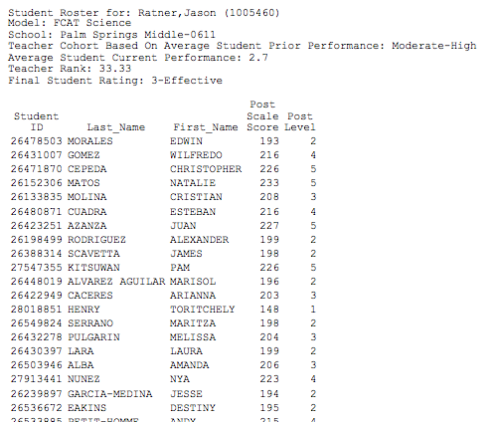
Cohort Model Teacher Rosters (MS)
Notes:
Rosters of students included in the Student Performance Rating are also provided for teachers through the Principal and available on SharePoint. The rosters, include the teacher’s cohort, average performance, rank and model rating as well as a list of students included. Principals should share the rosters with teachers. If a teacher has not been provide the roster they may request it from their principals.

Slide 21
RESOURCES AND SUPPORT
FDOE Performance Evaluation
http://www.fldoe.org/teaching/performance-evaluation/
FDOE Student Growth
http://www.fldoe.org/teaching/performance-evaluation/student-growth.stml
Professional Development – Teacher Evaluation https://www.palmbeachschools.org/staffdev/teacherevaluation/
Deliberate Practice https://www.palmbeachschools.org/staffdev/deliberatepractice/
JENC Newsletter https://www.palmbeachschools.org/staffdev/jenc/
Research & Evaluation – Student Performance Resources
https://growth.palmbeachschools.org/
Notes:
Thank you for listening, additional information may be found at these links. Again, specific questions may be submitted through the link included on the teacher’s letter.

